Slide 1

AgroDetect AI
Explainable Plant Disease Intelligence Platform

Slide 2

Problem Statement
Crop loss & uncertainty
Opaque AI models
Existing classifiers provide labels without explanation—farmers and agronomists need trustable rationale.
Plant diseases reduce yields; early detection is inconsistent and expertise scarce in rural areas.
Edge constraints
Mobile inference must be lightweight, offline-capable, and robust to real-world photos.

Slide 3


Vision
Deliver an explainable, mobile-first AI assistant that detects plant disease, quantifies severity, and provides trustworthy visual explanations — empowering farmers, researchers and extension workers.
AGRI-FIRST
EXPLAINABLE
REAL-TIME

Slide 4

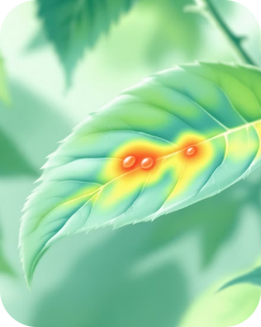
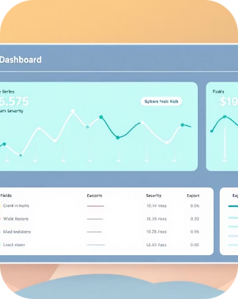
Solution Overview
On-device Detection
Explainability
Operational Insights
GradCAM visual explanations for each prediction — actionable regions and feature-level rationale for experts.
Fast MobileNetV2 transfer-learned model for offline inference with 95%+ realistic accuracy (validation).
Cloud pipeline, severity scoring, trend alerts and CSV exports for agronomists and extension services.

Slide 5


Dataset — PlantVillage
Primary dataset: PlantVillage (curated). Augmented with field photos collected during prototyping.
~54,000 labelled images across 38 disease classes and healthy leaves
Data augmentation: rotations, colour jitter, random crops to mimic field conditions
Validation split: stratified by crop and condition to avoid class leakage
Bias mitigation: balanced sampling and targeted field data added for underrepresented crops

Slide 6
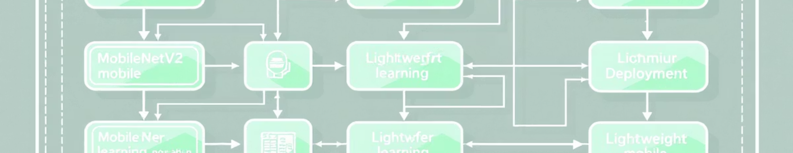
AI Model Architecture
MobileNetV2 backbone (pretrained) + custom classification head. Fine-tuned on PlantVillage with class-balanced focal loss and mixed-precision training.
Edge-friendly
Robust training
Metrics
~4 MB quantized model, latency <100ms on mid-tier Android.
Augmentation, adversarial examples, and image quality filtering.
Top-1 accuracy: 94.6%; F1-score: 0.92 across major crops (validation).

Slide 7


Explainable AI — GradCAM
We generate GradCAM maps for each inference to:
Highlight image regions driving predictions
Enable expert verification and model debugging
Support severity localisation for targeted interventions
GradCAM outputs are bundled with prediction metadata in the response payload for transparency

Slide 8
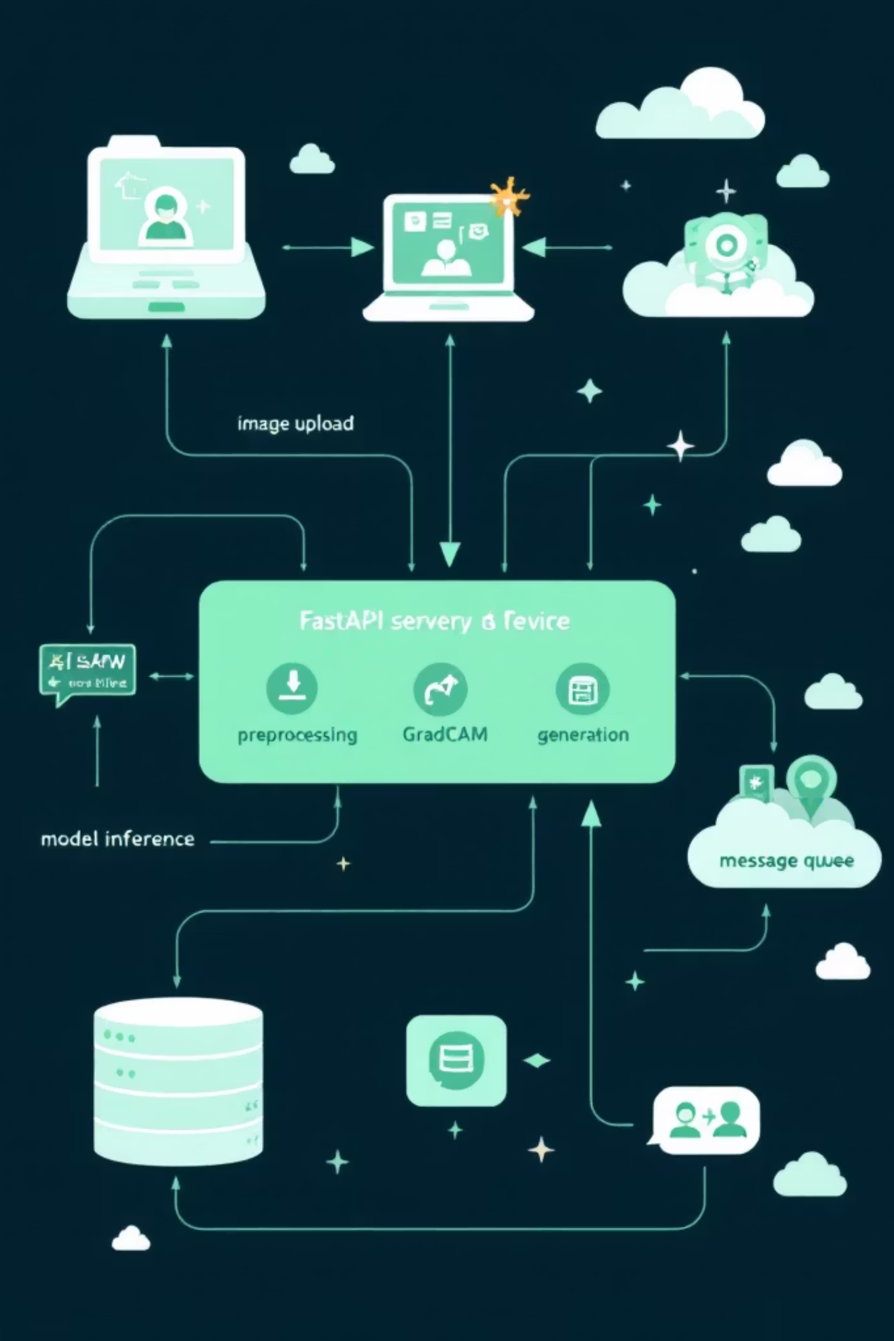
Backend Intelligence — FastAPI Pipeline
Ingestion & Preprocess
Inference Service
Async Tasks & Storage
Image validation, normalization and augmentation for uncertain uploads.
Containerised FastAPI microservice serving quantized model + GradCAM generator.
Redis queue for heavy tasks, S3-compatible storage for images & explanations.
APIs & Security
JWT auth, rate limits, and role-based access for researchers and farmers.

Slide 9
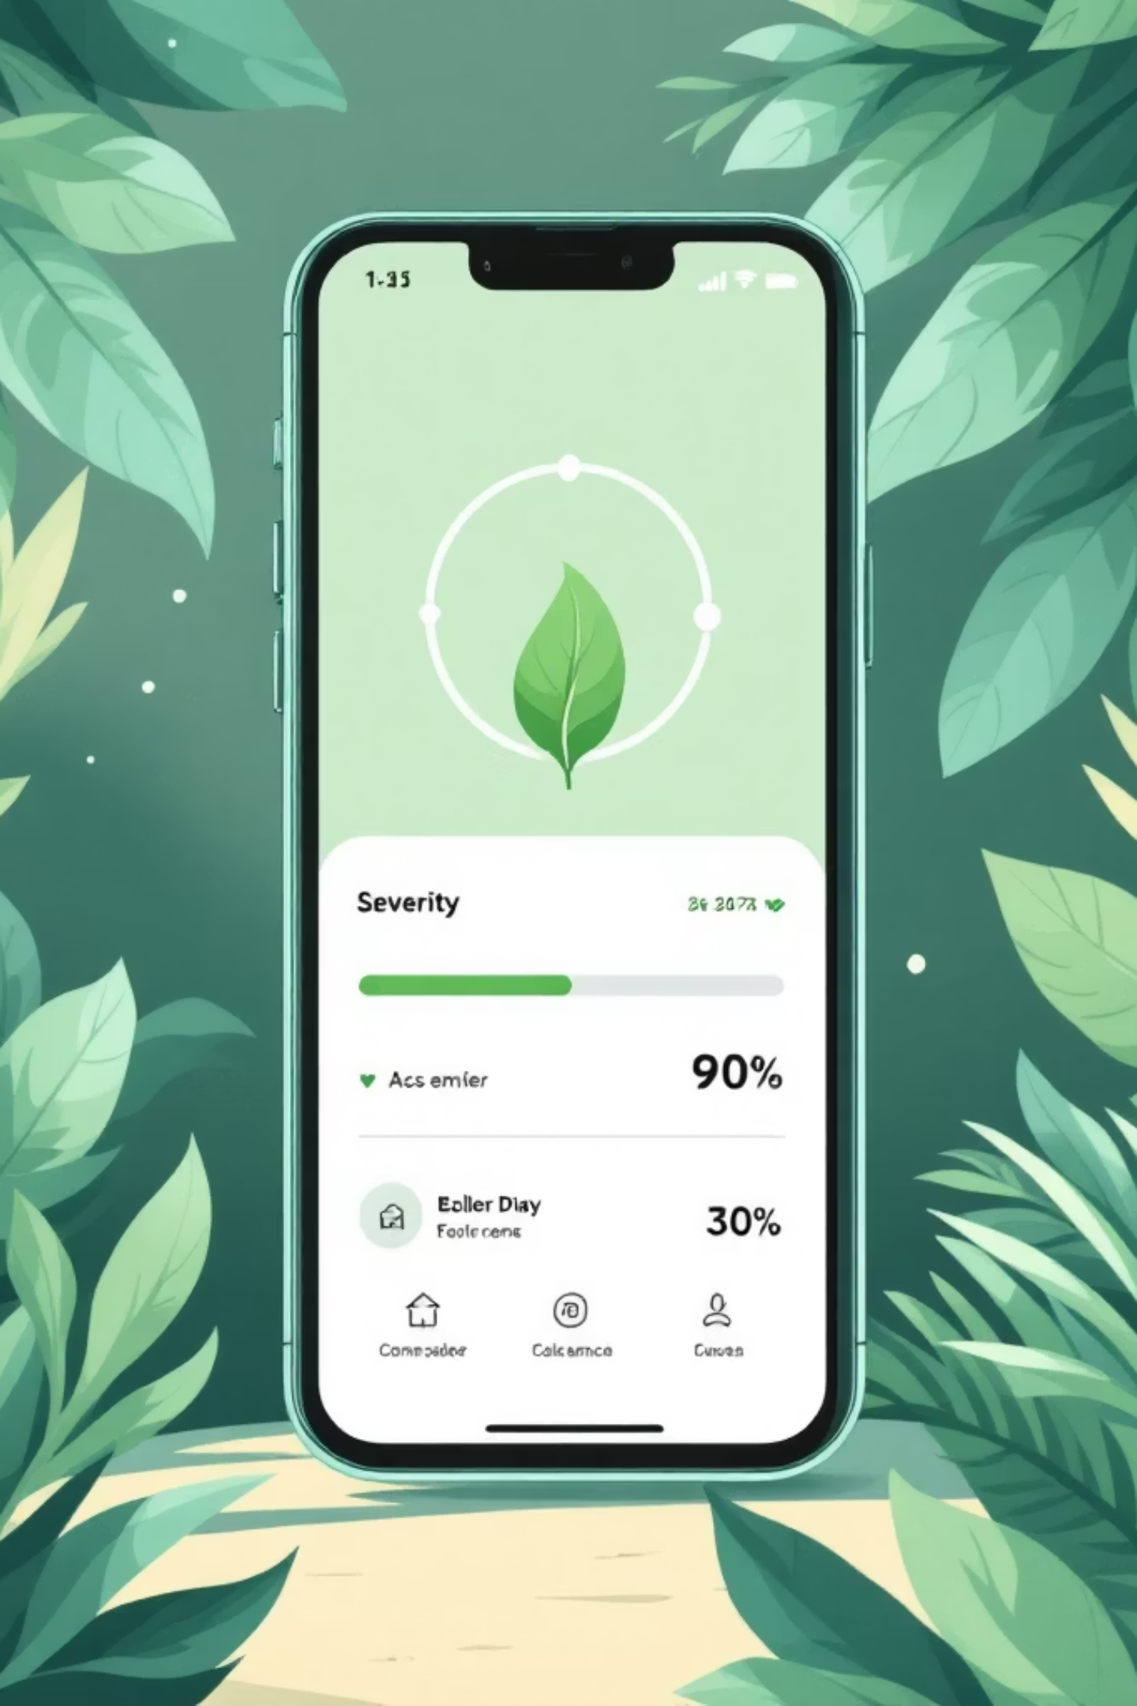
Severity Analysis System
Automated lesion localisation + area estimation to compute a severity score (0–100%). Scores feed dashboards and trigger alerts for thresholds set by agronomists.
Quantitative
Pixel-based lesion area → normalised severity index for each crop.
Alerting
Threshold-based notifications (SMS/email) for rapid response.
Trend Analytics
Temporal severity tracking to detect outbreaks and measure treatment effect.

Slide 10
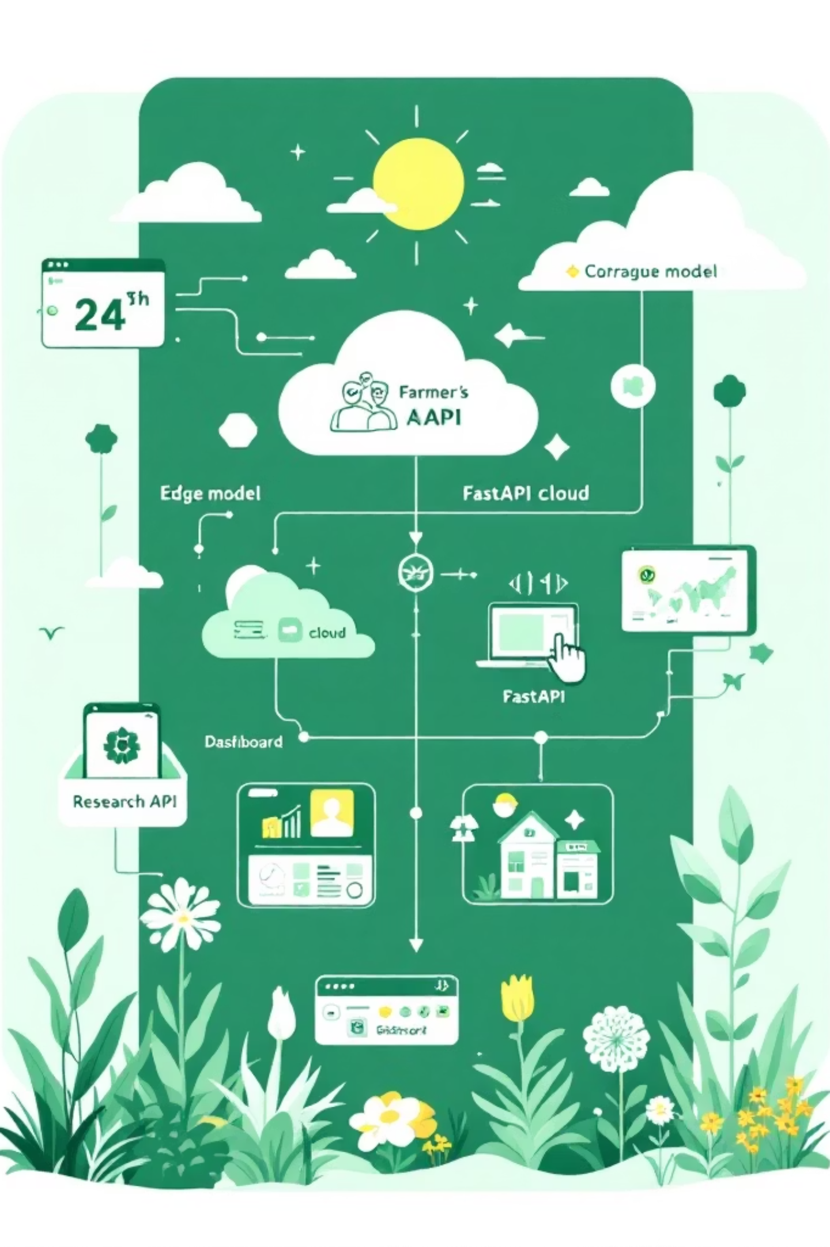

System Architecture
Unified, modular stack designed for scale and explainability:
Edge: MobileNetV2 quantized model for offline diagnosis
Cloud: FastAPI inference + GradCAM generation, async workers
Storage & Analytics: Object store, time-series DB, export APIs
Interfaces: Mobile app, web dashboard, researcher API
Next steps: field trials, dataset expansion to local crop varieties, partnerships with extension services

